Slide 1


LANGUAGE TRANSLATOR
--DANUSHRAJ M

Slide 2

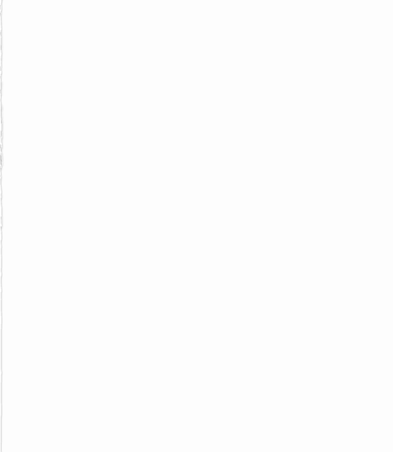
TOOLS & PACKAGES USED
Python 3.6
---Tinker
--Googletrans
--pyttsx3
--speech_recognition

Slide 3
REQUIREMENTS
WINDOWS XP,7,8 or 10
INTERNET CONNECTION

